Slide 1

Building a Custom Packet Sniffer to Detect Reconnaissance
A Presentation for JHU APL’s QNN team
by: Ethan Hart

Slide 2




AGENDA
About Me
The Problem
Approach
Results
Challenges & Considerations

Slide 3





About me
Education
Experience

Slide 4
The Problem: Preventing Cyberattacks before they happen

Slide 5
The reconnaissance phase
Passive Reconnaissance vs. Active Reconnaissance
Capabilities:
- Host Discovery
Operating System Detection
Multiple Protocol Scans
Firewall Evasion

Slide 6

goal: Build a packet Sniffer that can detect operating system scans
Why OS Scans?

Slide 7
The approach

Slide 8
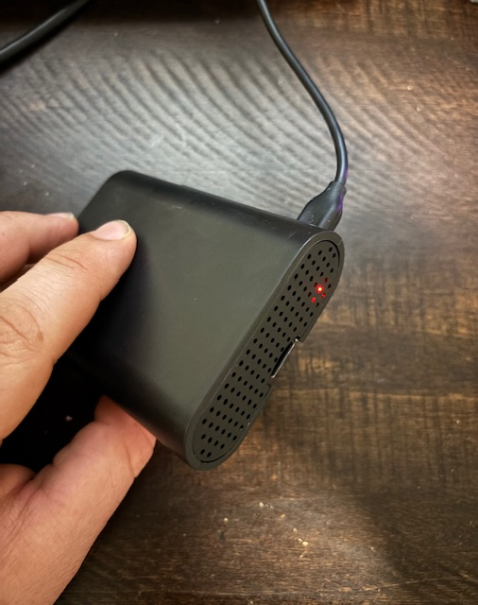
Tools, devices, and more
Host Device: Raspberry Pi 3 Model B
Designated VPN Server for my devices
Running Raspbian (Flavor of Debian Linux)
Configured with a static IP address

Slide 9


Tools, Devices, and more (Continued)
Languages
Libraries
LibPcap
Netinet
Scapy
Wireshark

Slide 10
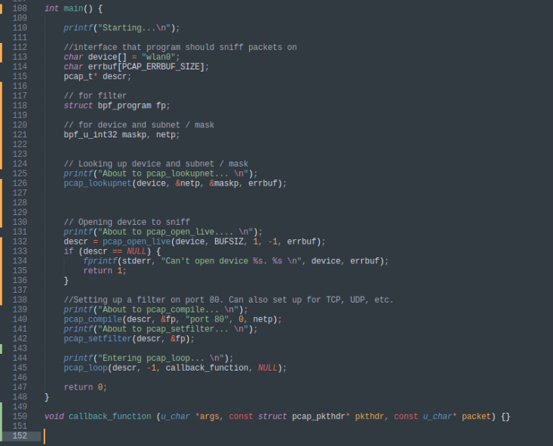
Step 1: building a packet sniffer
Many documented walkthroughs on building a basic packet sniffer with Libpcap.
Program Flow
Look up network device
Open the device for sniffing
Set up packet filters
Process each packet

Slide 11


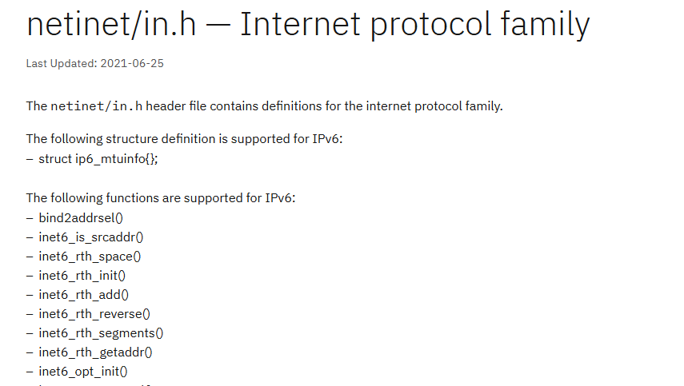
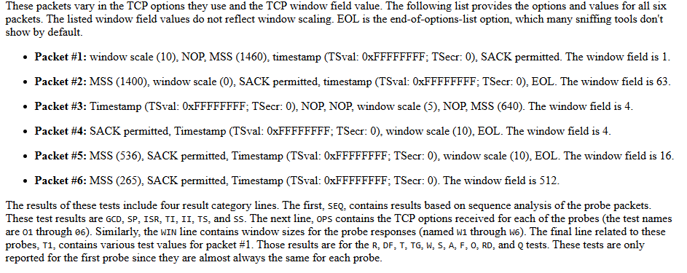
Step 2: Research – What to look for?

Slide 12
Findings - Windows
TCP Windows
Unusual Sizing?

Slide 13
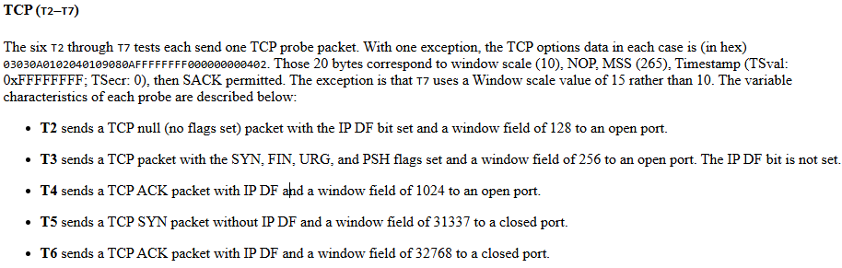
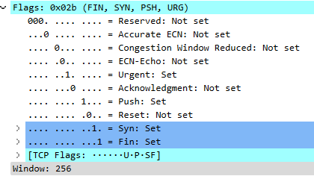


Findings - Flags

Slide 14
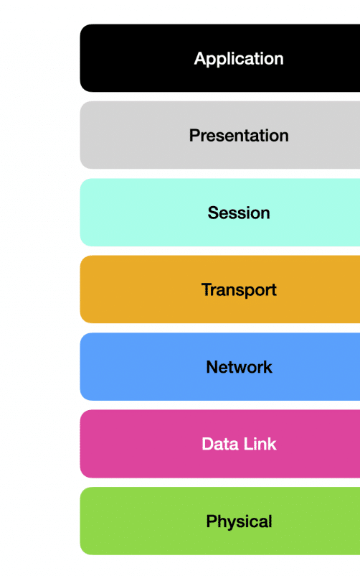
Strategy for Packet processing
Unpack packets from Data Link (Ethernet) and Network (IP) layers to access the TCP header in the Transport Layer
Inspect TCP window sizes for unusual numbers
Look for known window size -> flag fingerprints
Print additional packet statistics

Slide 15
Results

Slide 16
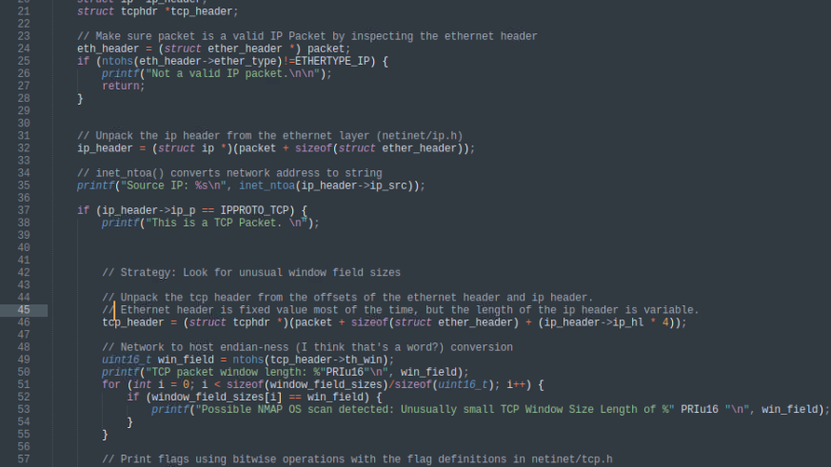
Processing function snippet

Slide 17
Demo
Nmap vs. packet sniffer

Slide 18
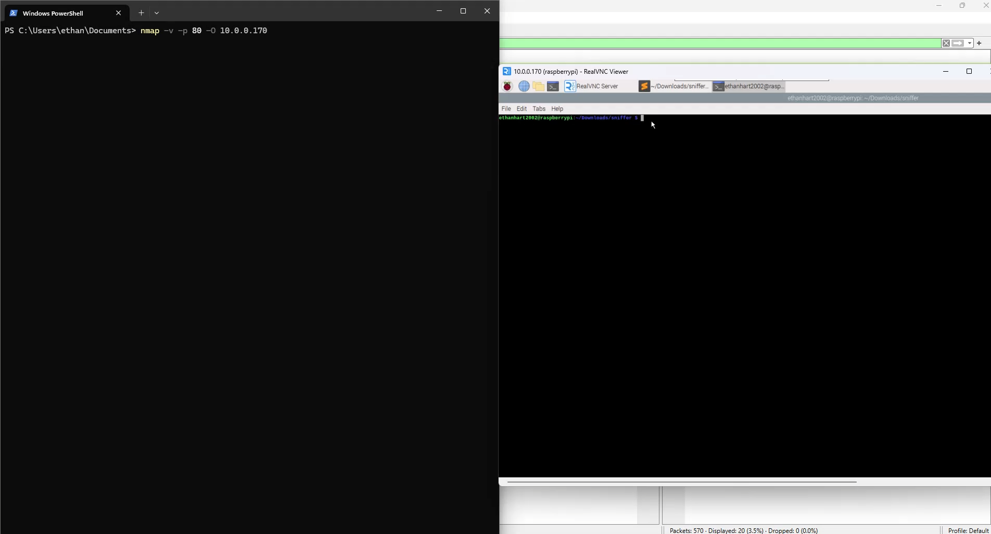

Slide 19
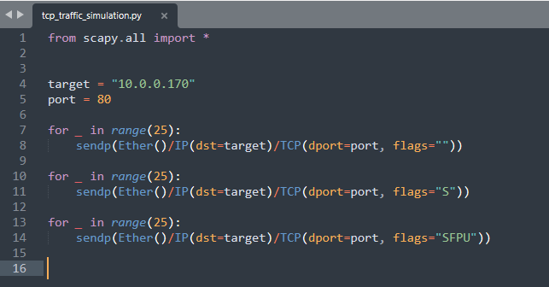
Bonus test: Simulating normal traffic

Slide 20
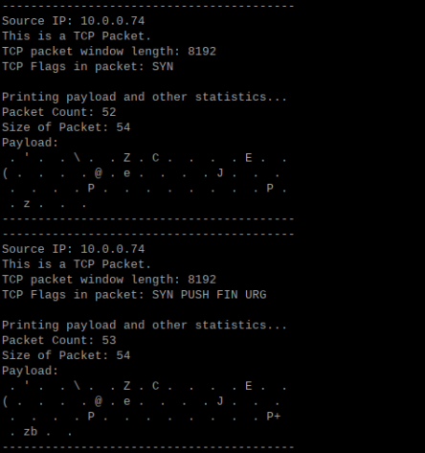


Slide 21
Challenges & Considerations

Slide 22

Source Code Available
Github.com/ethanhart2002/nmap_packet_sniffer

Slide 23
Resources
NMAP OS Scanning Guide
Dev-Dungeon Libpcap Guide
TCP Packet Format
Netinet Docs
Open Source 4 U Guide
GitHub Link

Slide 24
Thank you!
Ethan Hart
202-664-7301
ethanhartdev@gmail.com

